Slide 1

Introduction to Dynamic Compilation
Course code : CSA1475
Course name : Compiler Design for LANCE
Project by:
N. Venkata Vamsi Krishna(192210416)
G. Ram Charan(192210439)

Slide 2
What is Dynamic Compilation
Dynamic compilation is a powerful technique that optimizes software performance at runtime. By analyzing and transforming code on-the-fly, dynamic compilers can adapt to changing conditions and user workloads, yielding significant performance gains compared to static compilation.
.
Problem Statement
This problem statement aims to address the need for an efficient, secure, and adaptable dynamic compilation system that enhances the performance and flexibility of software applications in various execution environments.

Slide 3
Objectives:
Performance Optimization: Enhance program execution through real-time optimizations.
Resource Management: Efficiently use memory and CPU resources without causing significant overhead.
Security: Ensure that the dynamic compilation process does not introduce vulnerabilities.
Compatibility: Support a wide range of programming languages and platforms.
User Control: Provide tools for users to configure and monitor the compilation process.

Slide 4
Advantages of Dynamic Compilation
1
Improved Performance
2
Adaptive Optimization
Dynamic compilation can optimize code at runtime, leading to faster execution speeds compared to static compilation.
By analyzing runtime behavior, dynamic compilers can apply optimizations tailored to the specific hardware and software environment.
3
Language Interoperability
4
Reduced Memory Footprint
Dynamic compilation enables seamless integration of code written in different programming languages, improving software reuse and flexibility.
Dynamic compilers can selectively compile and load only the necessary code, leading to a smaller memory footprint for the application.

Slide 5
Profile-Guided Optimization
Runtime Analysis
Adaptive Optimizations
Iterative Refinement
Targeted Transformations
Profile-guided optimization analyzes the runtime behavior of a program to identify performance bottlenecks and guide optimization decisions.
By leveraging runtime data, the compiler can make more informed choices about which optimizations to apply, leading to better performance.
The process is iterative, with the compiler refining its optimization strategies based on feedback from runtime profiling.
Profile-guided optimization allows the compiler to focus its efforts on the most critical code regions, leading to more effective performance improvements.

Slide 6
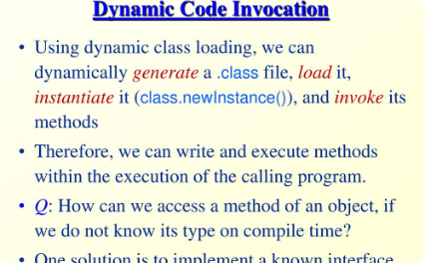
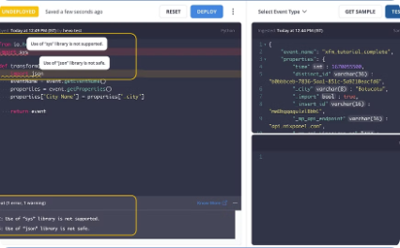
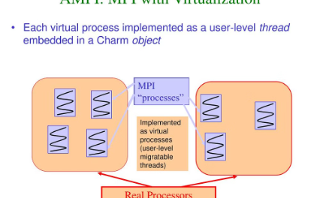
Dynamic Code Generation
Runtime Code Generation
Code Transformation
Adaptive Runtime Systems
The process of dynamic code generation typically involves analyzing the running program, identifying opportunities for optimization, and then generating and compiling new machine code to replace the original code at runtime.
Dynamic code generation involves the creation of executable code at runtime, allowing programs to adapt and optimize themselves on the fly. This technique enables just-in-time compilation and adaptive optimization for improved performance.
Dynamic code generation is often used in advanced runtime systems, which can continuously monitor a program's execution and make real-time decisions to optimize performance by generating and injecting new code segments.

Slide 7



Proposed design
Prediction
1
Analyzing runtime behavior to anticipate future needs
Optimization
2
Proactively optimizing code based on predictions
Feedback
3
Monitoring results and refining the prediction model
Speculative optimization is a dynamic compilation technique that aims to enhance performance by predicting future execution patterns and proactively optimizing the code. This approach analyzes runtime behavior, makes informed guesses about future needs, and applies targeted optimizations. The process is iterative, with feedback loops to refine the prediction model over time.

Slide 8



Feedback-Directed Optimization
Monitoring Performance
Continuously measure and analyze program behavior to identify performance bottlenecks and opportunities for optimization.
Adaptive Optimization
Dynamically apply optimizations based on runtime data, adjusting the compiled code to the actual workload.
Iterative Refinement
Repeatedly refine the optimized code, applying new techniques and incorporating feedback from previous optimizations.

Slide 9
Challenges and Limitations
While dynamic compilation techniques offer significant performance benefits, they also present some key challenges and limitations. The overhead of runtime compilation and optimization can introduce latency, especially for short-running programs. Accurately profiling application behavior to guide optimization decisions can also be complex.
Additionally, the effectiveness of dynamic optimization is highly dependent on the specific workload and hardware characteristics. Techniques that work well for one application may not generalize to others. aims to make dynamic compilation more robust and widely applicable.

Slide 10

Conclusion and Future Trends
As dynamic compilation techniques continue to evolve, we can expect to see further advancements in performance optimization for complex software systems. Future trends may involve deeper integration with hardware, leveraging emerging technologies like machine learning, and expanded support for diverse execution environments.

